Slide 1
Rapid, Flexible, and Open Source Big Data Technologies for the U.S. National Climate Assessment
Chris A. Mattmann Senior Computer Scientist, NASA JPL Adjunct Assistant Professor, USC
Member, Apache Software Foundation

Slide 2
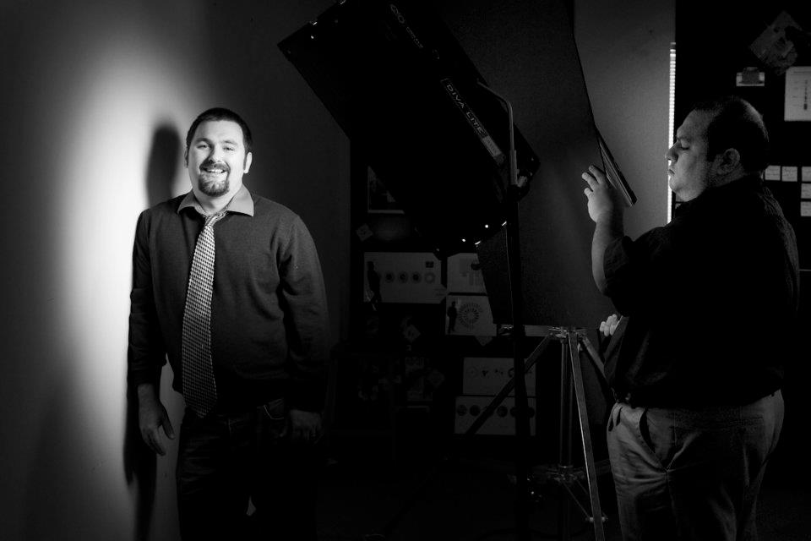
And you are?
Apache Member involved in
OODT (PMC), Tika (PMC), Nutch (PMC), Incubator (PMC), SIS (PMC), Gora (PMC), Airavata (PMC)
Senior Computer Scientist at NASA JPL in Pasadena, CA USA
Software Architecture/Engineering Prof at Univ. of Southern California

Slide 3
Agenda
What is the U.S. National Climate Assessment
The Regional Climate Model Evaluation System
Snow Hydrology for the Western US and Alaska
Where are we going/Future Work

Slide 4
What is the U.S. National Climate Assessment?
Credit: Kathy Jacobs

Slide 5
What is the U.S. National Climate Assessment?
Goal
Enhance the ability of the United States to anticipate, mitigate, and adapt to changes in the global environment.
Vision
Advance an inclusive, broad-based, and sustained process for assessing and communicating scientific knowledge of the impacts, risks, and vulnerabilities associated with a changing global climate in support of decision-making across the United States.
Credit: Kathy Jacobs

Slide 6
NASA Center Call for Proposals for NCA
I am a Co-I on 2 separate efforts for NASA’s contributions to the U.S. NCA
Enabling Regional Climate Model Evaluation: A Critical Use of Observations for Establishing Core NCA Capabilities – PI: Waliser (Co-Is Linda Mearns [NCAR], Jinwon Kim)
Snow and Ice Climatology of the Western United States from MODIS - PI: Painter

Slide 7
Will spend the talk discussing those two projects
And the innovations in Big Data, and open source we have engendered along the way
Regional Climate Model Evaluation System (RCMES)
RCMED scalable cloud database
RCMET analysis toolkit/Virtual Machine
JPL Snow Server/Snow Science Computing Facility
Data Processing at scale
Re-processing and distribution
Open Source Apache OODT based system

Slide 8
RCMES: Motivation
Global Climate Models (GCMs) provide the only quantitative, physically-based means for predicting climate change.
Regional climate models (RCMs) are key to downscaling global predictions for quantifying climate change impacts on scales relevant to decision-support and assessment activities.
Systematic evaluations of GCMs have been undertaken for some time (e.g., AMIP, CMIP), this is not the case for RCMs.
NASA can provide critical and unique observational resources and technological leadership to facilitate RCM evaluation and thus make key contributions to the climate assessment process.

Slide 9
A New Regional Climate Model Evaluation Framework
Goal
Streamline climate model evaluation procedure for efficient processing of climate data
Facilitate the application of quality estimated climate model data to impact assessment and policy development via advanced computational framework by combining massive database and processing toolkit
Benefits
Improved understanding of model strengths/weaknesses allows model developers to improve the models
Improved understanding of uncertainties in predictions of specific variables over specific regions for end-users
Allow researchers to spend more time analyzing results and less time coding and worrying about file formats, data transfers

Slide 10
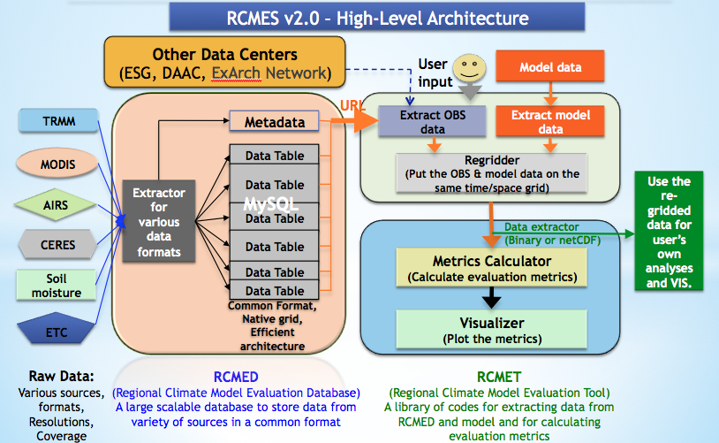
Use of RCMET for NARCCAP + CORDEX + STEEDS
Cloud DB evaluation
Delivery as Cloud VM + Easy RCMET
Data Movement Study

Slide 11
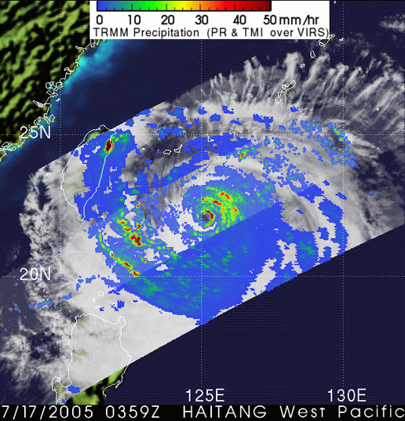
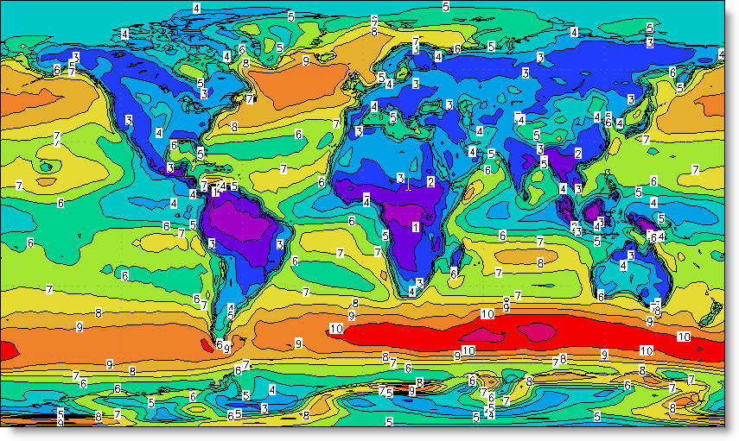
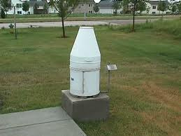
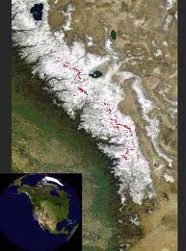
Datasets in RCMES
RCMED Datasets (now or near-term):
MODIS (satellite cloud fraction): [daily 2000 – 2010]
TRMM (satellite precipitation): 3B42 [daily 1998– 2010]‏
AIRS (satellite surface + T & q profiles) [daily 2002 – 2010]
ERA-Interim (reanalysis): [daily 1989 – 2010]
NCEP Unified Rain Gauge (gridded precipitation): [daily 1948 – 2010]
CRU TS 3.0: precipitation, Tavg, Tmax, Tmin [monthly 1901 – 2006]
Snow Water Equivalent over Sierra Nevada Mts [monthly 2000-2010]
NASA MERRA Land Surface Assimilation [daily, 1979-2011]
CERES radiation – Surface and Top of the atmosphere
University of Delaware precipitation and temperature analysis
(Future) CloudSat atmospheric ice and liquid, Satellite-based snow (Himalayas), ISCCP cloud fraction, MERRA (water vapor, surface and pressure-level variables), Sea-level heights, Fine-scale SST, etc.
RCMET Metrics:
Bias (e.g. seasonal means or variance)
RMS error (e.g. interannual variability)
Anomaly Correlation (spatial patterns of variability)
PDFs (likelihoods, extremes and their changes)
Taylor Plots & Portrait Diagrams (overall model performance)
Statistical Tests
User-defined regions (e.g. water shed, desert, sea, political)

Slide 12
RCMED data model
And store to that model in MySQL (federated), HIVE, or MongoDB
Extractors decimate format and model heterogeneity

Slide 13




Cloud DB Evaluation
We started with MySQL
…and then broke it at 6B data points
…and then federated it, and broke it again
Then we experimented with Hadoop/HIVE
Query times scaled with the amount of nodes we added
Schema-less with geo query support
Currently Evaluating

Slide 14

DB Improvements
Handle daily data
More voluminous, requires scalability in RCMED web service API, and also elasticity in data warehousing
Collaboration with ACCESS11 CCMODS Project (PI: Hua; Science PI Fetzer)
Easily switch between different DB backends
Improved web service to select DB backend and search across MySQL, HIVE, and PostGIS
Submitted Earth Science Informatics Paper

Slide 15
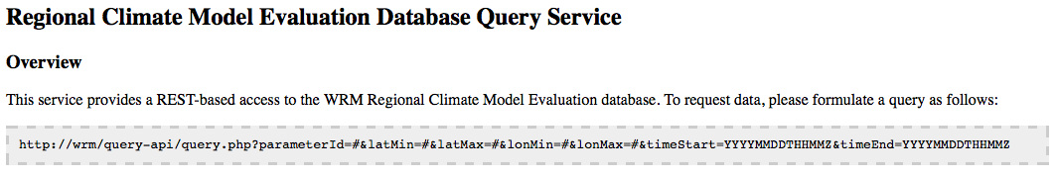
RCMED API
The RCMED API:
- Search the entire database
- Space/Time box
- Simple RESTful URL
- Simple ASCII result format
Augmenting with OPeNDAP via this project

Slide 16
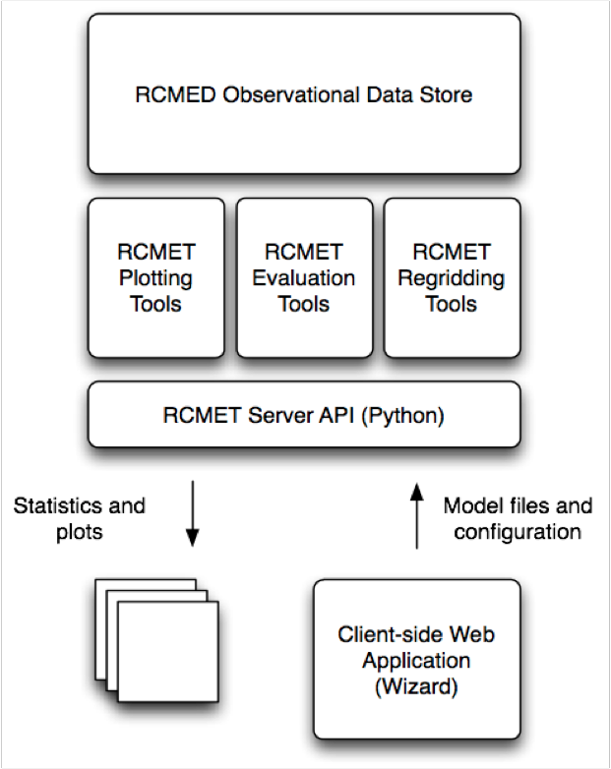
RCMET Architecture
Use web service from RCMED
Regrid onto obs or model grid
Seasonal, monthly or annual temporal compositing
Perform metric (bias, RMSE, etc.)
Output plot using NCAR NCL
Bottle Python web services
PHP Wizard Front End
Forcing data for impact assessment models

Slide 17
RCMET VM Improvements
Config A Centralized RCMED VM-based RCMET
Config B Centralized RCMET and RCMED

Slide 18
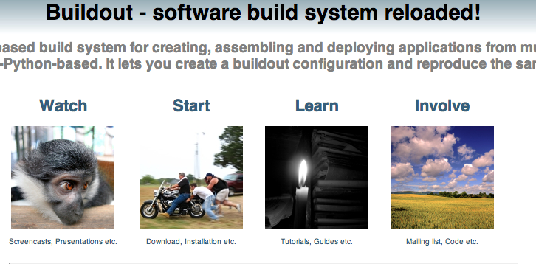

Easy RCMET and Vagrant
Leveraging Python Buildout system to construct “Easy RCMET”
Useful in scenario where sysadmin at local institution won’t run VM for science user
Leveraging Vagrant for automatically (de-)construct VM

Slide 19
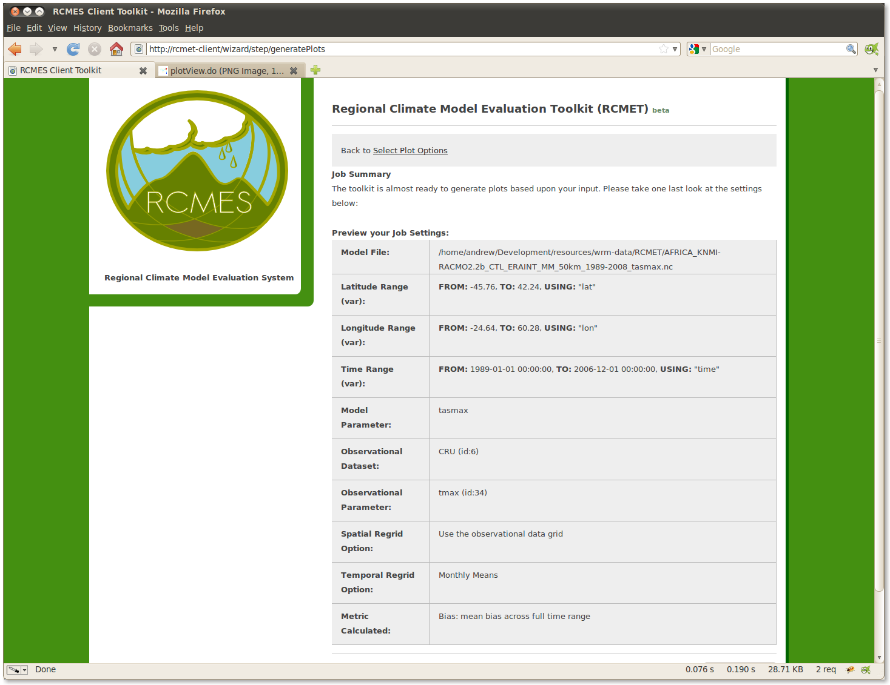

Slide 20
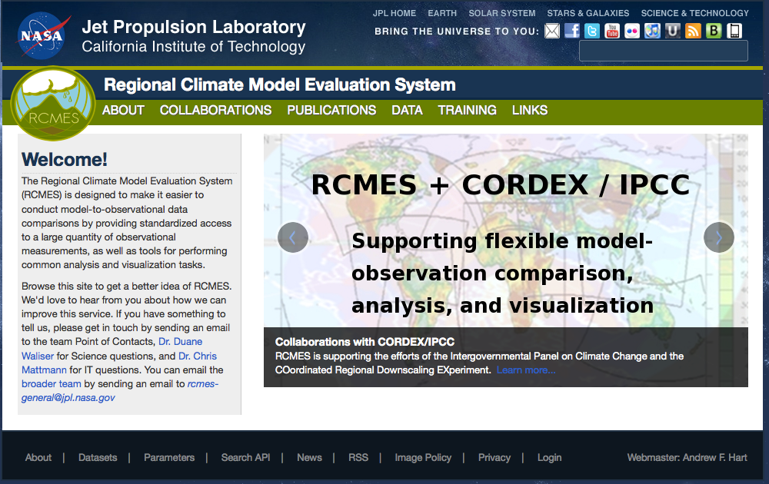
Our new website
New Public Facing Web site
Links to Publications, data available from RCMED
Software/API Specifications
Information about Collaborators
http://rcmes.jpl.nasa.gov/

Slide 21
Interactions with partners
WCRP’s CORDEX (Coordinated Regional Downscaling Experiment)
2.5 PB of data
NARCCAP is N. American contribution to this
Have initiated major interactions and collaborations including demonstrations at every major CORDEX meeting
Trieste Kickoff; East Asia 2011; East Asia 2012; South Asia 2012; Arctic 2012
U.S. National Climate Assessment
Earth System Grid Federation (ESGF)
Will house CORDEX outputs
Climate and Development Knowledge Network

Slide 22
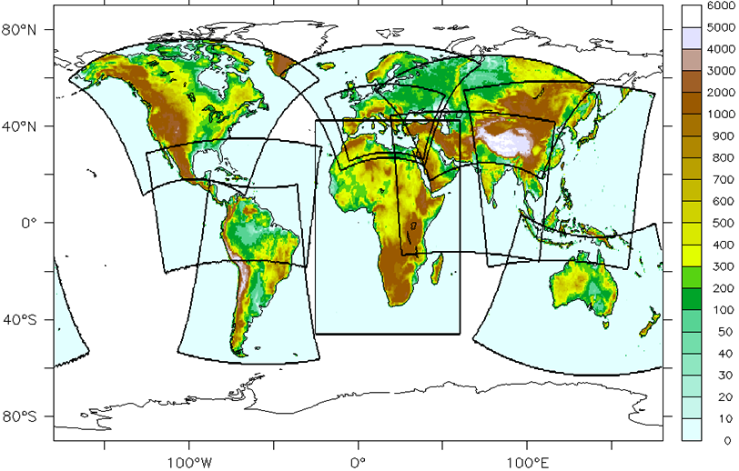
Application to WCRP CORDEX
Africa – collaboration & analysis ongoing (UCT, Rossby Ctr), funded by CDKN
N. America –funded via NASA for U.S. NCA (NCAR, NARCCAP)
E. Asia – exploring collaboration (KMA, APCC), participating in both workshops
S. Asia – hosted Dr. Sanjay, collaboration at October mtg., IITM using RCMES
Arctic – collaborating with SMHI, Rossby Ctr; hosted M. Cooke from Paul Kushner
Not Illustrated Here
Arctic & Antarctic Domains

Slide 23
Example application for CORDEX-Africa
Annual Cloudiness Climatology Against MODIS; 2001-2008
Kim et al. 2012a; Climate Dynamics, accepted.
MODIS
Taylor Plot
ENS
Ens Mn

Slide 24
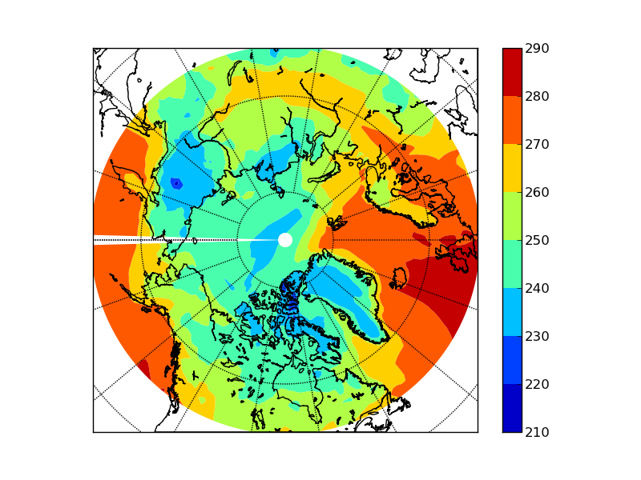
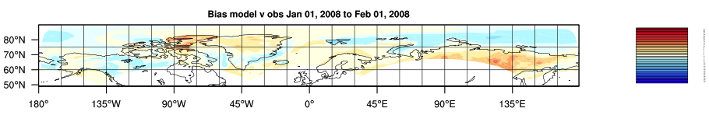
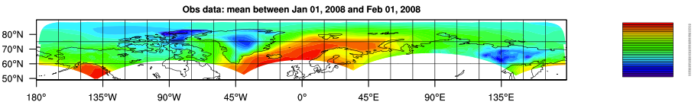
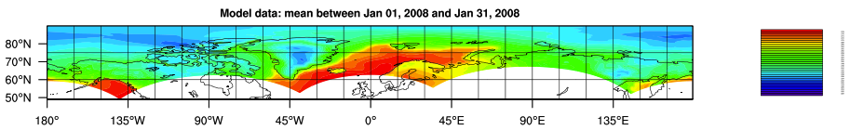
Demonstration: CORDEX Arctic
Worked with Melanie Cookie/Paul Kushner (U. Toronto), Cameron Goodale, (JPL)
Compared Near-Surface Air Temperature with ERA 2 Metre Temp
Selected time range: 2008/01/01 00:00 2008/02/01 00:00
Use Model grid
Calculate time mean for full period.
Bias: mean bias across full time range
ftp://ftp.cccma.ec.gc.ca/pub/yjiao/CanRCM4/

Slide 25

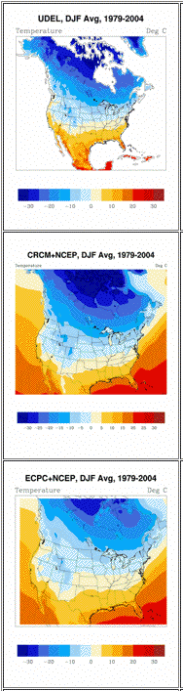
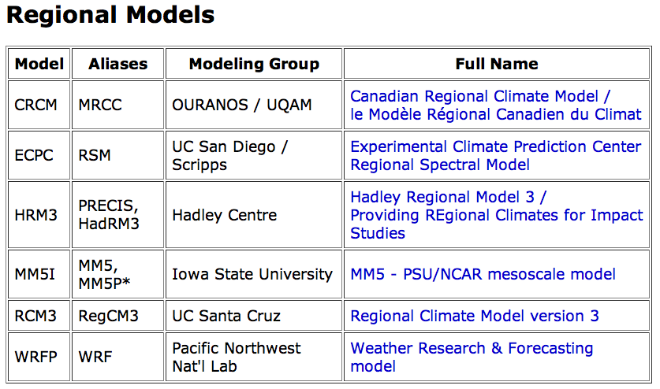
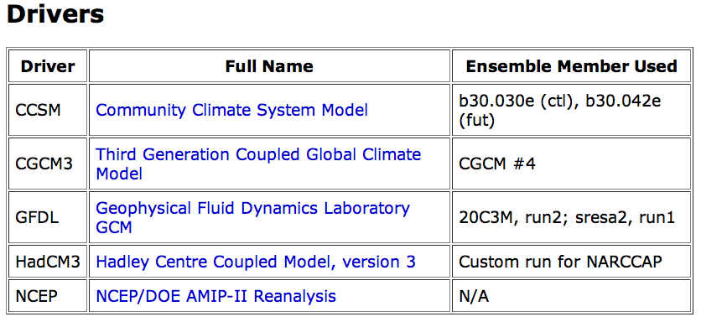
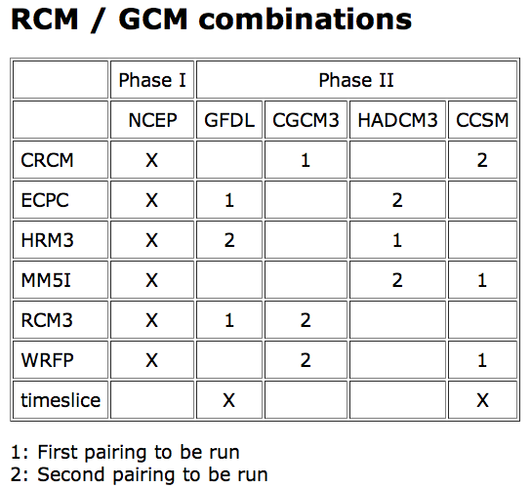

NARCCAP
NARCCAP is the North America Regional Climate Change Assessment Program (PI: L. Mearns, NCAR).
Several RCMs downscaling future climate change projections from GCMs.
RCM performance needs to be characterized against observations using present-day simulations.
NARRCAP is the U.S./N.A. contribution to CORDEX.

Slide 26
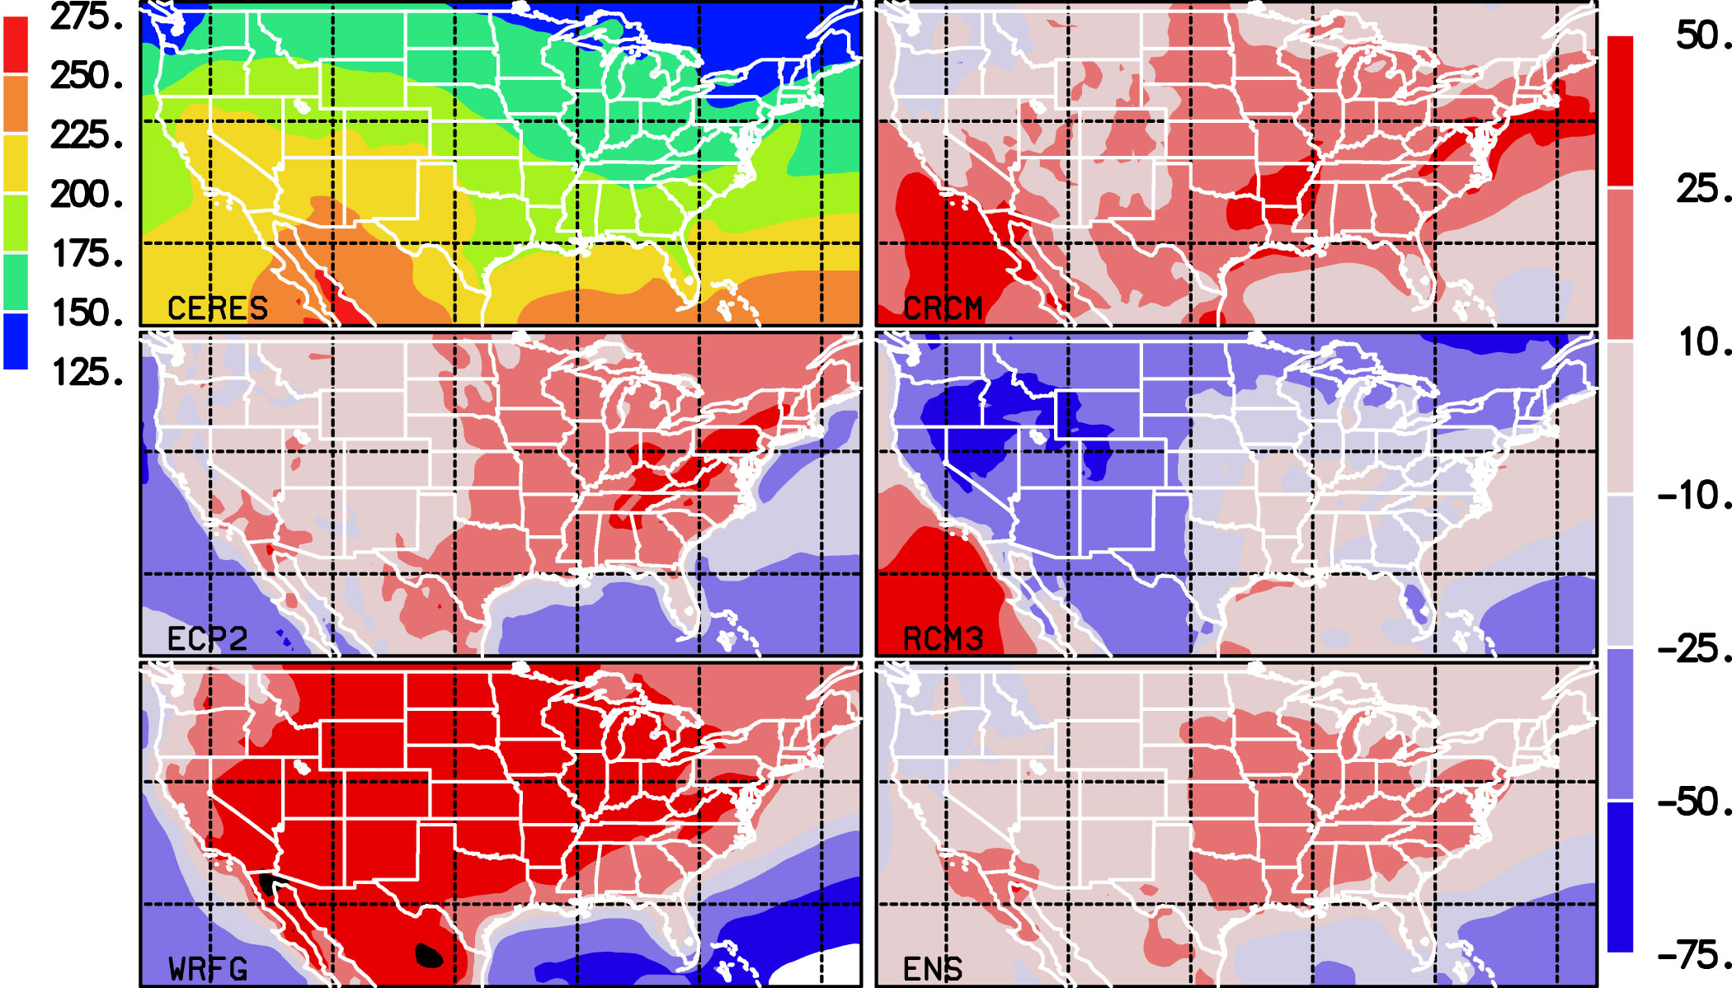
NARCCAP Multi-decadal Hindcast Evaluation Results Limited/Preliminary
Figure. The conterminous US domain. The boxes indicate the locations of the 14 subregions.
The monthly-mean time series of the daily-mean surface air temperatures and precipitation over the conterminous US region from five RCMs (Table 1) that have participated in the NARCCAP hindcast experiment have been evaluated against the CRU data for the 24-year period 1980-2003.
The RCM simulations, mostly at 50km horizontal resolutions, are interpolated onto a common grid nest of 0.5-deg horizontal resolution for analysis, evaluation, and inter-comparison (Figure).
Fourteen sub-regions (as depicted in the figures and table) are selected for closer examinations of model performances in various regions of interests (Table 2).
Kim, J., D.E. Waliser, C.A. Mattmann, L.O. Mearns, C.E. Goodale, A.F. Hart, D.J. Crichton, and S. McGinnis, 2012: Evaluations of the surface air temperature, precipitation, and insolation over the conterminous U.S. in the NARCCAP multi-RCM hindcast experiments using RCMES. J. Climate, Accepted!.
Figure. RCM biases in surface insolation against CERES
Table 1. The RCMs evaluated in this study.
Model ID | Model Name
M01 | CRCM (Canadian Regional Climate Model)
M02 | ECP2 (NCEP Regional Spectral Model)
M03 | MM5I (MM5 – run by Iowa State Univ.)
M04 | RCM3
M05 | WRFG (WRF – run by PNNL)
ENS | Model Ensemble (Uniform weighting)
Table 2. The relationship between precip & insolation biases.
Model | Land-mean bias – Precipitation (mm/d) | Land-mean bias - Insolation (Wm⁻²) | Bias pattern Correlation
CRCM | 0.33 | 10.2 | -0.47
ECP2 | 0.41 | 9.0 | -0.28
RCM3 | 0.54 | -29.9 | -0.50
WRFG | -0.08 | 30.4 | -0.18
ENS | 0.25 | 4.9 | -0.62

Slide 27

To Open Source
Recently approved to release RCMES to the Apache Software Foundation
Apache Incubator Proposal accepted
http://wiki.apache.org/incubator/ClimateProposal
(in coordination with Tsengdar Lee/HQ, Laura Carriere/GSFC, numerous US and intl’ univ.)
Join us http://climate.incubator.apache.org/

Slide 28
Switching gears to the JPL Snow Server

Slide 29
Outline: Introduction to the Snow Data System
Data Sets and Functionality
Near Real Time and Historical MODIS Snow Cover and Size processing systems
Near Real Time and Historical MODIS Dust Radiative Forcing processing systems
Data Access:
Western Energy Balance of Snow (WEBS)
SNOWMAP (map overlays) Web-based Distributed Authoring and Versioning (WebDAV)

Slide 30
Satellites providing Snow Products
Satellite | Sensors | Quantities
Terra | MODerate Resolution Imaging Spectroradiometer (MODIS) 500 m spatial resolution ~daily temporal resolution | Snow covered area Snow albedo Snow grain size Dust/BC radiative forcing
Aqua | MODerate Resolution Imaging Spectroradiometer (MODIS) 500 m spatial resolution ~daily temporal resolution | Snow covered area Snow albedo Snow grain size Dust/BC radiative forcing
NPOESS Preparatory Project (NPP) - Suomi | Visible Infrared Imaging Radiometer Suite (VIIRS) 750m spatial resolution ~daily temporal resolution | Snow covered area Snow albedo Snow grain size Dust/BC radiative forcing
Landsat Data Continuity Mission (LDCM) (launch February 2013) | Operational Land Imager (OLI) 30 m spatial resolution 16-day temporal resolution | Snow covered area Snow albedo Snow grain size Dust/BC radiative forcing
Notes:
There are additional sensors carried by these satellites – the sensors measuring quantities useful for flood/drought are listed in the table.

Slide 31
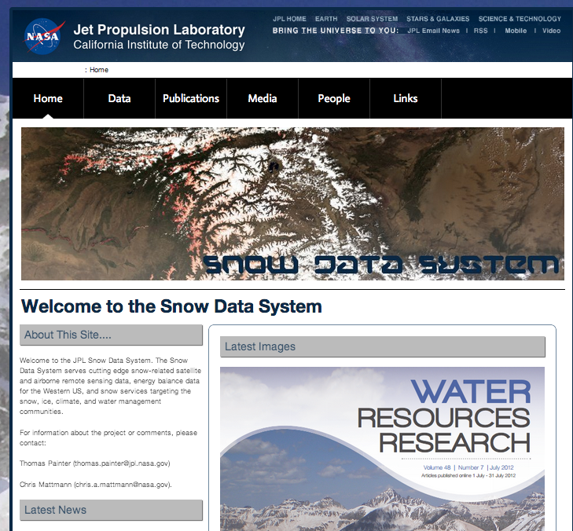
JPL Snow Server
http://snow.jpl.nasa.gov
Full bore processing and delivery system
Near real time and historical processing
Dust forcing and snow covered area products
Tower data
GIS interfaces
CSV, JSON, GeoTIFF data format download

Slide 32
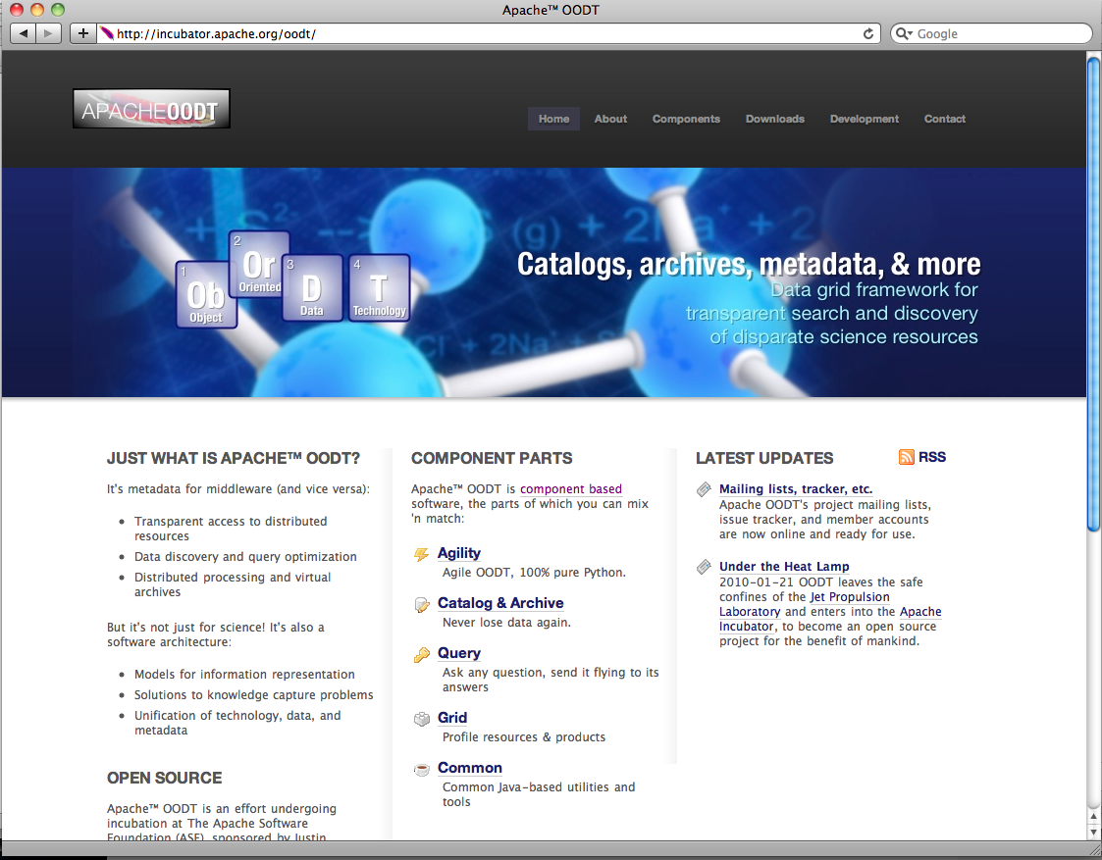










Apache OODT
Entered “incubation” at the Apache Software Foundation in 2010
Selected as a top level Apache Software Foundation project in January 2011
Developed by a community of participants from many companies, universities, and organizations
Used for a diverse set of science data system activities in planetary science, earth science, radio astronomy, biomedicine, astrophysics, and more
OODT Development & user community includes:
http://oodt.apache.org
32

Slide 33
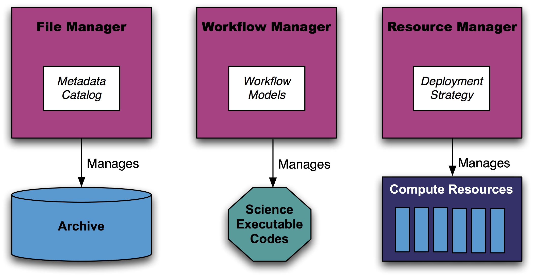
Apache OODT Core Components
All Core components implemented as web services
XML-RPC used to communicate between components
Servers implemented in Java
Clients implemented in Java, scripts, Python, PHP and web-apps
Service configuration implemented in ASCII and XML files

Slide 34
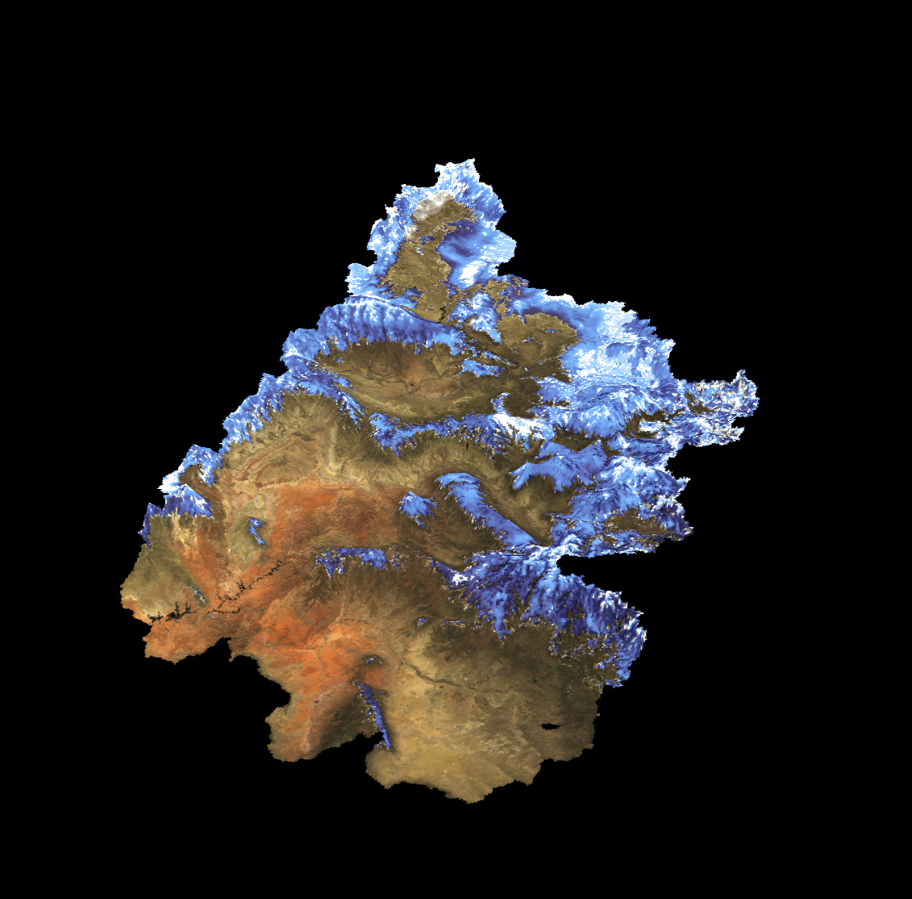
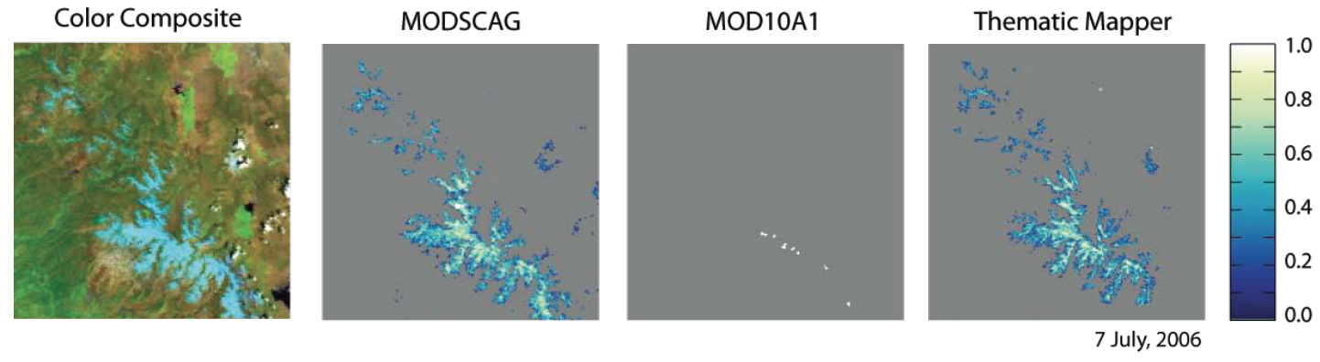
MODIS Snow Covered Area and Grain Size (MODSCAG)
JPL MODSCAG algorithm
(Painter et al 2009)
Spectral mixture analysis of MODIS Surface Reflectance products
Daily 500 m coverage in late morning and early afternoon from NASA satellites Terra and Aqua
Upper Colorado River Basin
March 9, 2009

Slide 35
MODSCAG Processing: Two Products/ Two Inputs
MODIS tiles are defined by their horizontal and vertical tile IDs (the 2 characters after the h and the v respectively)
Historical Tiles over the Western United States (LPDAAC)
Time Range: 2000 - Present
h08v04, h08v05, h09v05, h09v04, h10v04
LPDAAC is NASA Land Processes data center located at the USGS Earth Resources Observation and Science (EROS) Center in Sioux Falls, South Dako
MODIS Near Real-Time Products (LANCE MODIS NRT)
Time Range: Dec 2011 - Present
Western United States
High Asia

Slide 36
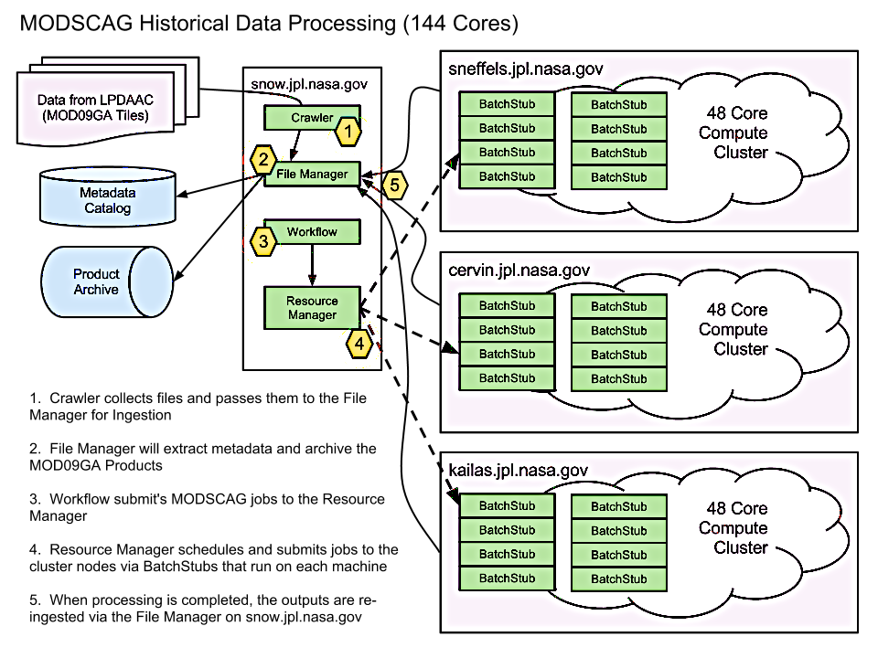

Slide 37
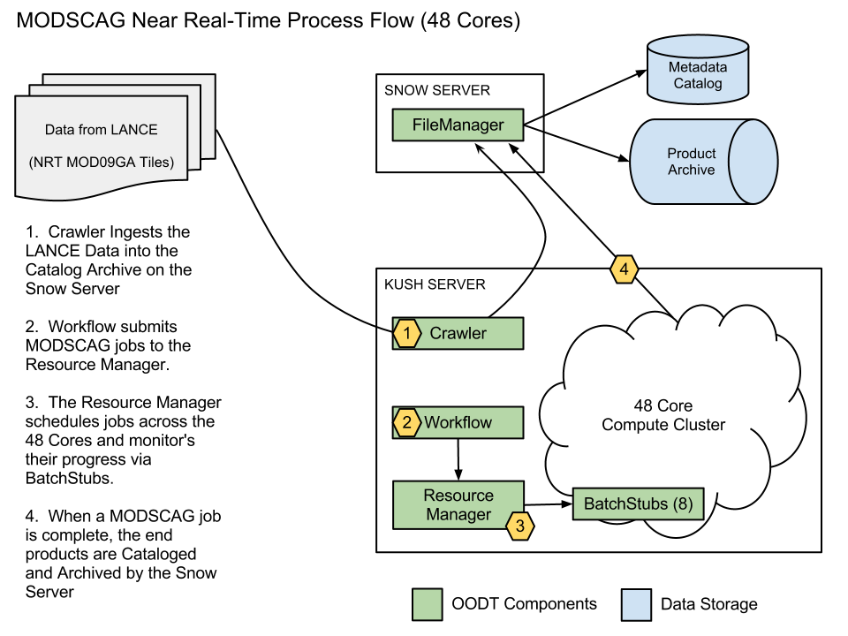

Slide 38
Dust Radiative Forcing
300
200
100
0
Dust Radiative Forcing (W/m²)
MODDRFS
Dust Radiative Forcing in Snow from MODIS
Painter and Bryant, 2012
17 May 2009

Slide 39
Dust Radiative Forcing Processing
Obtain MOD09GA Surface Reflectance Tiles for the Upper Colorado River Basin (h08v05, h09v04, h09v05, h10v05).
MODSCAG/MOD-DRFS file preparation: HDF extraction of surface reflectance bands, cloud properties, solar and sensor geometry.
MOD-DRFS algorithm computes radiative forcing by dust on snow.
MODSCAG/MOD-DRFS post-processing: cloud masking and de-striping

Slide 40
Dr. Tom Painter’s Western Energy Balance of Snow (WEBS) Tower Network
Network of heavily instrumented towers in snow- covered regions to facilitate modeling of the energy balance and melt of the snow cover, and dust/BC radiative forcing in the snow cover.
Standard measurements of meteorology (air temperature, wind speed, relative humidity, all at two heights), also incident and reflected broadband solar radiation and incident and reflected near infrared/shortwave infrared solar radiation

Slide 41
Western Energy Balance of Snow
Western Energy Balance of Snow (WEBS)
Historical And Near-Real-Time Access
Towers deployed in several key snow areas
Connect to towers and pull down data actively

Slide 42
WEBS Data Processing
http://snow.jpl.nasa.gov/portal/data/webs
Historical data:
Swamp Angel Study Plot: WY 2006 – Present
Senator Beck Study Plot: WY 2006 – Present
Grand Mesa Study Plot: WY 2009 – Present
Near-real-time collection:
Automated hourly refresh rate
Data Access
Interactive browser-based visualization
Customizable data product download

Slide 43
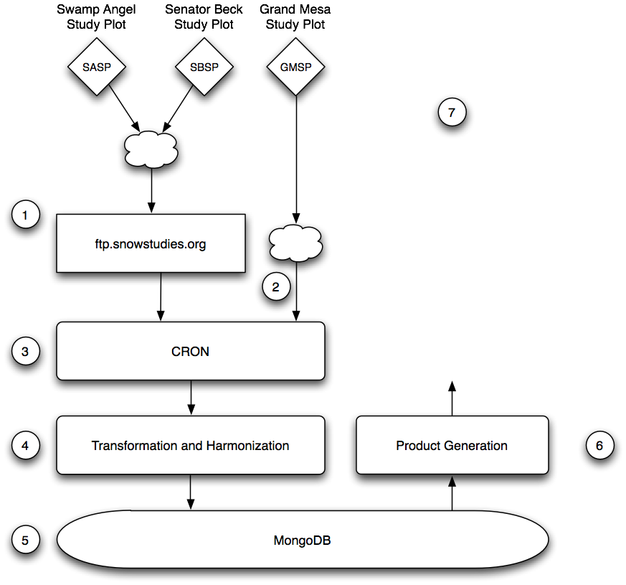
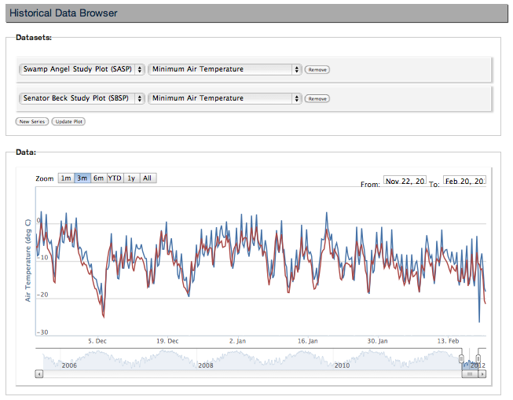
WEBS Data Collection Architecture
1) Data from SASP and SBSP staged to ftp.snowstudies.org
2) Data from GMSP obtained by direct connection to the tower
3) A Cron job pulls down the latest hourly data
4) Data from all stations is homogenized and cleaned
5) Data is stored in MongoDB for fast, scalable querying
6) Data is selectively extracted and formatted as needed for data delivery
7) Users interact with, and request, data via a browser-based interface.

Slide 44
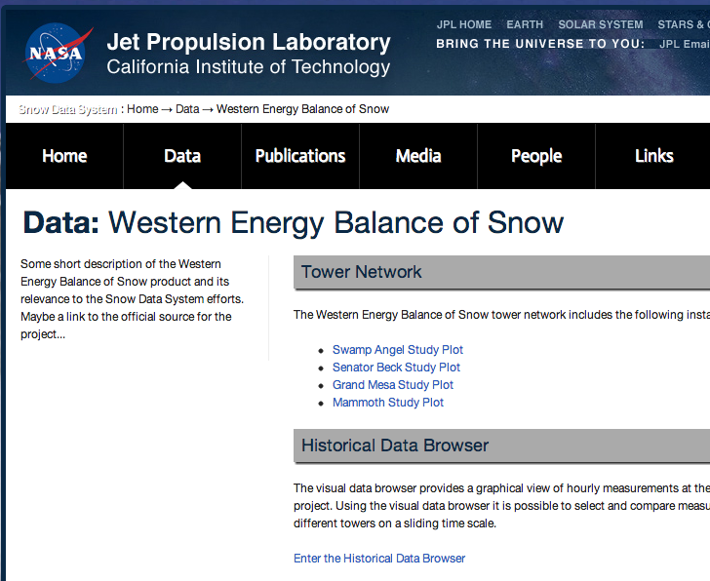
WEBS Browser Interface
http://snow.jpl.nasa.gov/portal/data/webs
Access to tower-specific information
Access to the full range of historical data

Slide 45
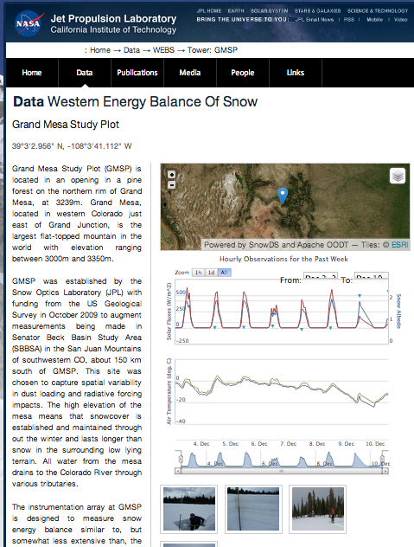
WEBS Browser Interface
Detailed Tower Information
Geographical location
Equipment background
Latest observational data
Site Photos
Data Download via CSV

Slide 46
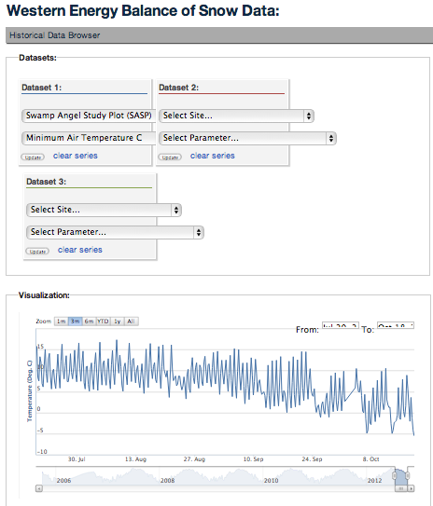
WEBS Browser Interface
Interactive data visualization
Select towers
Select parameters
Select date ranges
Select download format as CSV, JSON, etc.

Slide 47
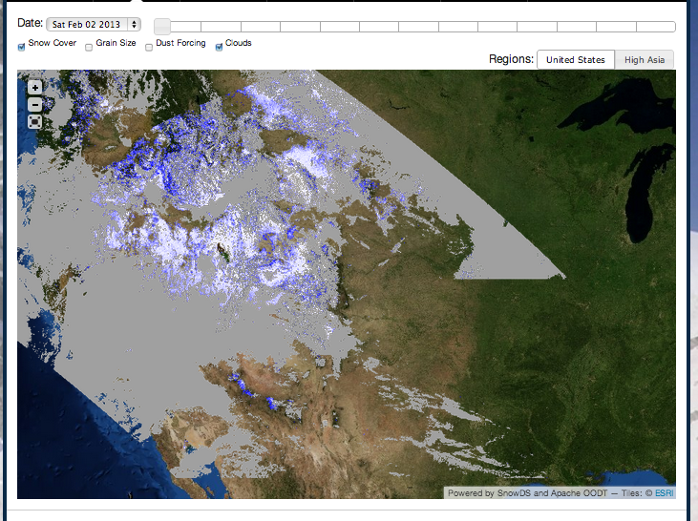
SNOWMAP– http://snow.jpl.nasa.gov/portal/data/map
Showing snow covered area layer and clouds
Products available as WMS (variety of formats)

Slide 48
Snow Map Architecture
Layers available Snow Cover
Grain Size Clouds
Dust Forcing
Snow Map
WMS
Tiles
ESRI Basemaps
Snow Data System
Publish
GIS Server
Data Access
Spatial / Attribute Query
http://snow.jpl.nasa.gov/gis/wms
GeoTIFFs on Disk
PostGIS
Credit Paul Ramirez 2011-2012
Notes:
Within the snow data system algorithms are being run to detect snow cover, grain size, and dust radiative forcing. One output of running these algorithms is a set of tiles, in the form of GeoTIFFs, that can be viewed as one large mosaic dataset that can be filtered based on time. This information is published to the GIS server by transforming the data using GDAL and updating the PostGIS database about a given tile for a particular day. To the external user the results of each of these algorithms will be exposed as a single WMS layer that will allow for filtering based on time. Moreover, there is a layer for the ancillary information that was used in the production of the data (i.e. rock, vegetation, cloud layer). These layers are placed on a basemap, which is currently being served by ESRI and publicly available, to give context to the information.
**Note we don't have PostGIS yet or the time based aspect but that is the next feature we are working on and will be based on the above architecture.

Slide 49
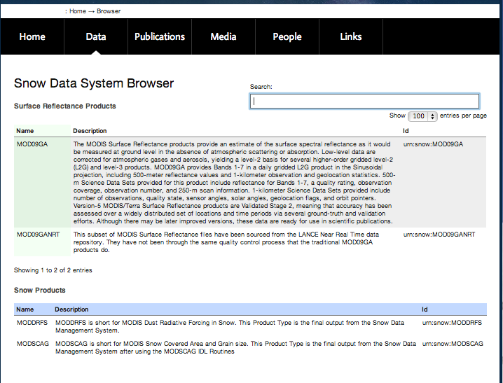
Data Product Browse/Download
Select dust forcing (MOD-DRFS) or Snow Covered Area (MODSCAG)

Slide 50
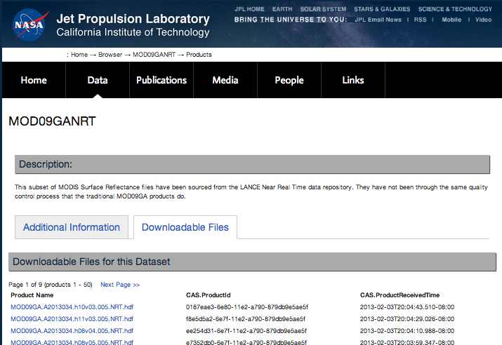
Product File Browser
Select a product
View received time
Sorted by received time
Latest on top

Slide 51
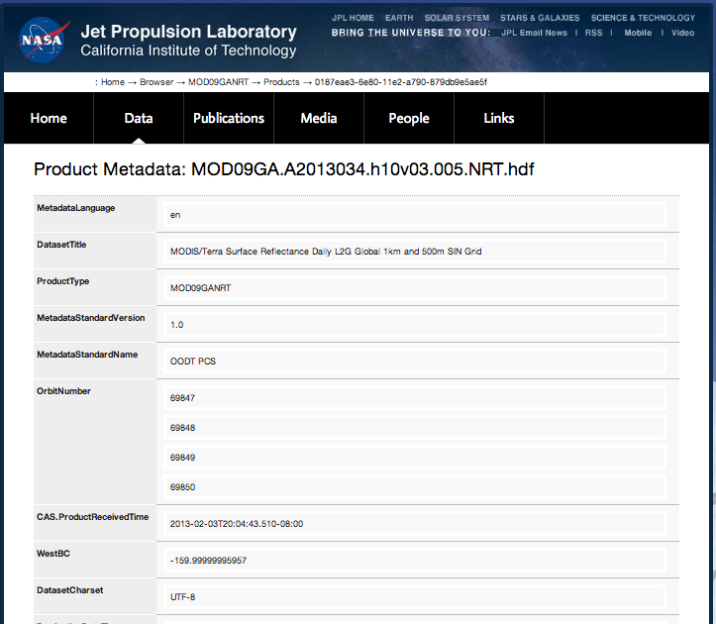
Per Product Metadata
View product metadata including upstream pedigree, and processing information

Slide 52
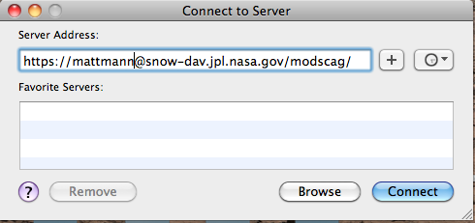
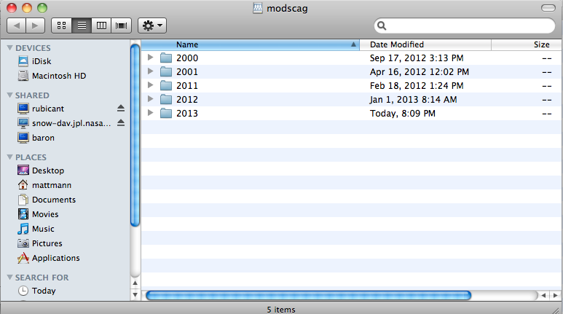
WebDAV Data Delivery
Web-based Distributed Authoring and Versioning (WebDAV)
Clients available on every major operating system
Can mount as disk on Mac
Can mount as folder on Windows

Slide 53
Collaborations and Users
Funded work on NASA Water Resources, and on Airborne Snow Observatory demonstration
NOAA Colorado Basin River Forecast Center
California Department of Water Resources
Bureau of Reclamation
Discussions ongoing with ESRI and Google Earth Engine
Partnering with UCLA on WEBS
McKenzie Skiles
NSIDC, Mary Jo Brodzkik & Marilyn Kamanski

Slide 54
Summary
Regional Climate Model Evaluation System
Key tool for use in the NCA for comparison of remote sensing data/in-situ observations to climate model outputs (e.g., from CORDEX, NARCCAP, CMIP5)
JPL Snow Server
Rapid science computing facility for reprocessing generation of better snow covered area and dust radiative forcing measurements from MODIS
Data dissemination, and delivery, GIS
Snow and Ice Climatology for the Western US and Alaska

Slide 55
Questions?
Chris Mattmann chris.a.mattmann@nasa.gov @chrismattmann on Twitter

